Slide 1
Onboarding
November 2024

Slide 2
About Bocconi Students Fintech Society
The Bocconi Students Fintech Society is a community of passionate Bocconi University students with deep interest and expertise in financial technologies.
Our mission is to raise awareness about fintech's transformative potential while providing guidance for students exploring career opportunities in this dynamic field.
Our primary goal is to cultivate and share insights into the pivotal role of companies reshaping global financial services. We bring together ambitious students eager to embrace challenges and delve into the future of finance.
Since our establishment in 2017, we have been the leading fintech association at Bocconi University, consistently creating innovative ideas and opportunities for our members.
Desks
Numbers
Generalist
M&A
Public Relations
Data Analysis
General fintech and innovation-related topics.
Goal : Large choice of subjects to gain a comprehensive view of fintech.
Investment insights on M&A, VC, and PE deals.
Goal : To develop expertise in Fintech M&A.
FinTech news, create educational material, and then publish them on social medias.
Goal : To know the latest news and developments
Through research, statistical analysis and visualization, the team will uncover trends and insights.
Goal : To apply your analytics knowledge into practice.
+45 active Members
(+ students in exchange)
+40 Reports & Slide sets
+25 Interviews available on our website
Our mission and the divisions
November 20, 2024

Slide 3
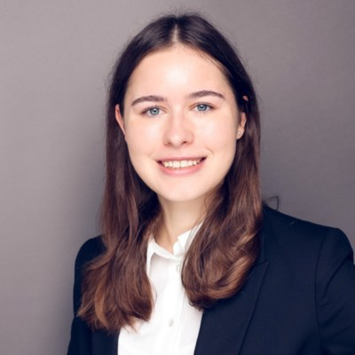
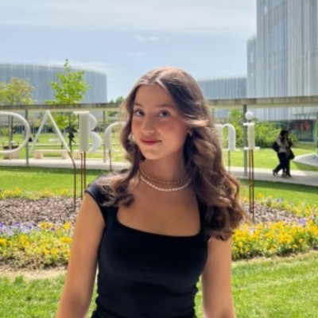
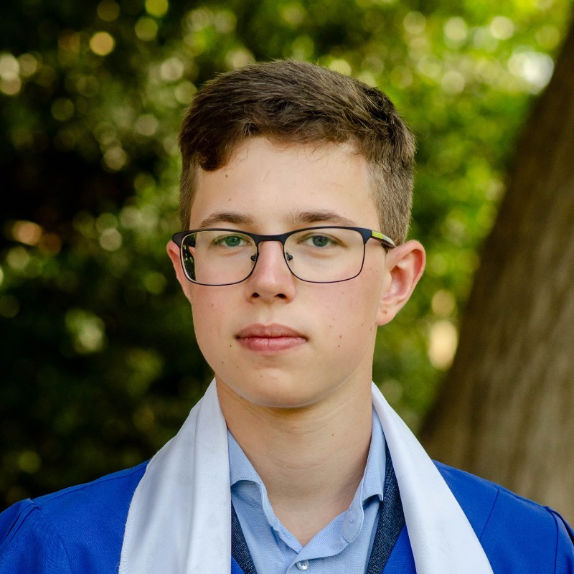
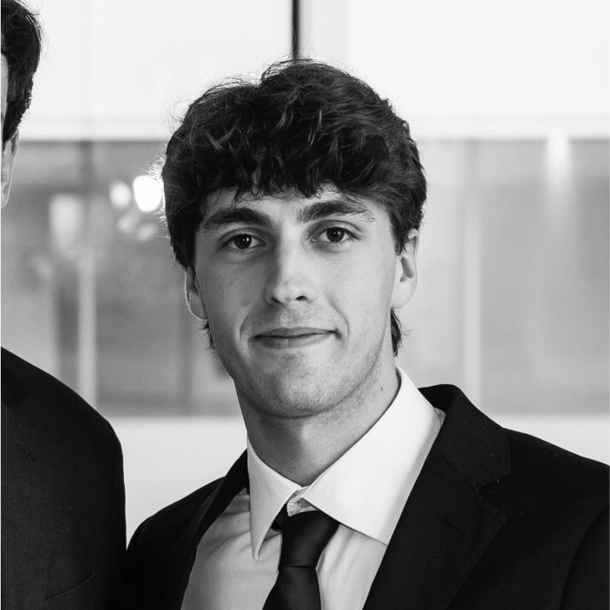
About Bocconi Students Fintech Society
Our Board consists of ambitious, dedicated and experienced students
Michelangelo Mauro
Vice-President, Head of Generalist
Guillaume Abaz
President, Head of Public Relations
Catharina Gärtner
Head of M&A
Clara Carlhammar
Head of Events
Gleb Legotkin
Head of Data Analysis
Matteo Nesiti
Head of Operations
The Board of Directors for the first semester of the 2024-2025 academic year
November 20, 2024

Slide 4
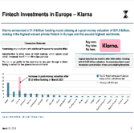
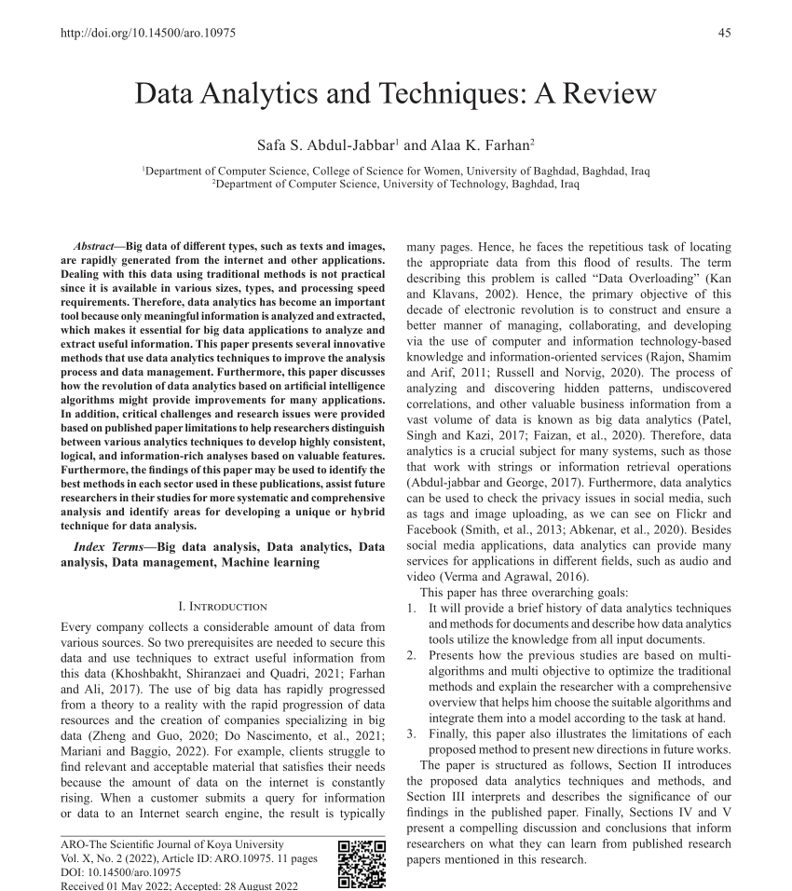
What we do
We explore emerging fintech topics through various channels.
Slides sets
Research Reports
Events
BSFS advocates for the creation of slide decks, as they are more accessible and quicker to read, making them an efficient way to convey information.
Reports that tackle a subject in depth aim to gain a comprehensive view of a specific topic based on strong research.
We organize events, workshops, and masterclasses opened only to our members or to the entire Bocconi community with high-level speakers
November 20, 2024

Slide 5
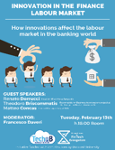
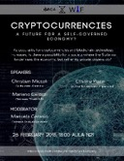
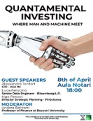
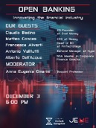
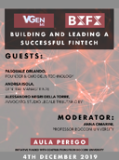
Our Past Events
Bocconi Students Fintech Society is committed to organize events in collaboration with leading associations and global organizations to gain hands-on insights.
Selected events from our past years
November 20, 2024

Slide 6
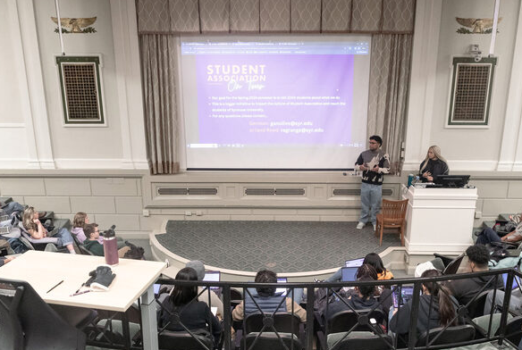
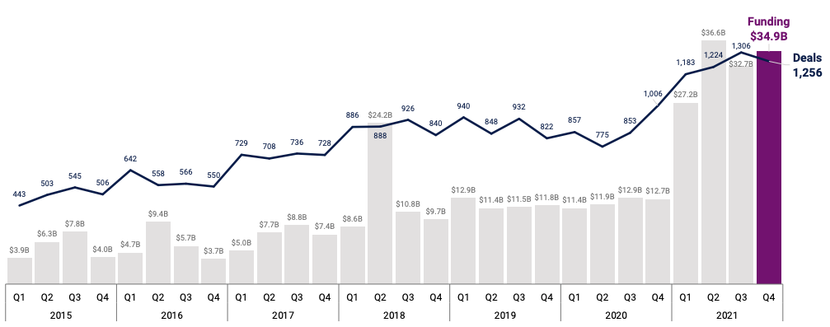
New Events
Internal Meetings
Networking Aperitivos
Projects & Articles presentation meetings
Fintech Market insights about news, deals, …
Goal: Get to know each others more and building a community of future fintech leaders.
Public events
This year flagship event : Venture Capital & Fintech, Investing in Fintech
Missions :
Contacting interesting personalities to invite
Define the outline of the events ( subject & its limits)
Pass the CASA Committee requirements
Organize practically the event and communicate on social media

Slide 7
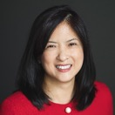
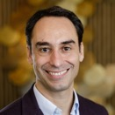
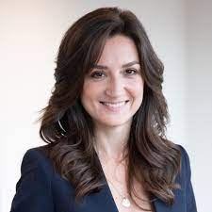
Interviews: our Coffee Chats
Some of our interviews with industry professionals available on our website:
Andrew Darley
IBM
Corrado Passera
Illimity
Oi Yee Choo
ADDX
Federico Sforza
AideXa
Andrea Pietrini
YourGroup
Betsy Cohen
Bancorp
Edoardo Volta
Mastercard
Giovanni Daprà
Moneyfarm
Giacomo Zaninetta
Agicap
Elena Lavezzi
Revolut
Donato Vadruccio
Plick (PayDo)
Francesco Passone
Klarna

Slide 8
Where we have operated
Here’s a world map illustrating where the leaders we interviewed and where our past members are located.
We aim to keep expanding our network and to make us known all over the world
November 20, 2024

Slide 9
Our network
BS Fintech Society has built a strong and wide network of future leaders around the world and in different industries: Fintech companies, Consulting, and Investment Banking.
November 20, 2024

Slide 10
C
Public Relations Division

Slide 11
About Public Relations
Goal: Keep up with the FinTech news, the events and reports of the association and create educational material, and then publish them on social media (Linkedin, Instagram mainly).
Content Research
Content Creation
Content Sharing
Important News
Relevant Fintech Topics
Social Media
How ?
Reports & Projects
Instagram
Bloomberg News
Events
LinkedIn
Financial Times
Fintech news
Website
Il Sole 24 Ore
Educational content
WIX Builder
Bocconi Students Fintech Society
@bocconistudentsfintechsociety
November 20, 2024

Slide 12
About Operations
Following, how Operations is organised:
HR & Controlling
Accounting
Global Outreach
Recruitment
Expenses Management
Corporate Relations
Assessment
Funds Collection
Internships
Project Management
In-company Visits
Partnerships
University Affairs
Contact with other students associations
November 20, 2024

Slide 13
About Global Outreach
What does Global Outreach do?
Corporate Relations
Internships
Partnerships
In-company visits
Increase the number of internships offered to BSFS members from the levels reached in the last academic years, by leveraging our network and the quality of works produced.
Reactivate the upward trend that BSFS saw in the last two years, during which the association collaborated with companies such as Unicredit and Borsa Italiana.
Contact companies about the possibility to organise in-company visits reserved to BSFS members or to the greater Bocconi community in general.
University Affairs
Competitions
Collaborations
In 2022, BSFS was invited by the Imperial College Finance Club to join the Royal Challenge (M&A Case Study Competition). We want to further explore the possibilities associated with such events.
In the past, we were able to organise together with BS Real Estate and BS Finance Society two events that were attended by more than 100 people. For 2024-2025 we intend to expand this type of collaborations.
November 20, 2024

Slide 14
Reactivate our partnerships
Bocconi Students Fintech Society seeks active partnerships and collaborations with professional firms and established associations
In the Summer of 2021, assoFintech agreed to initiate #FutureFintech - aimed at an audience of young university students with the aim of enhance financial education
In the Summer of 2021, Borsa Italiana agreed to collaborate with BSFS to promote financial education on a national level
In the Autumn of 2020, Consultique SCF, an independent financial analysis consultancy, agreed to collaborate on a survey and an event about the way financial advisory is implemented in Italy
In the Spring of 2021, BSFS began collaborating with IIA for the publication of IIA’s monthly newsletter and the content creation related to the insurtech ecosystem
We launched a partnership with UniCredit where we scout European Fintech startups in order to organize a “Demo Day” where they pitch.
In the Spring of 2020, ZEB Consulting’s Italy Branch agreed to collaborate on a position paper about retail banking’s stagnating industry
Selected partnerships and collaborations with professional firms
November 20, 2024

Slide 15
C
M&A Division

Slide 16
M&A: Secureworks acquired by Sophos
Deal Overview:
Deal Rationale :
Deal Value: ~$860 million
Date: October 2024
Target Company: Secureworks (NASDAQ: SCWX)
Acquirer: Sophos
Strategic Integration: Sophos aims to integrate Secureworks' services to enhance its cybersecurity offerings.
Strengthening Capabilities: The acquisition is intended to bolster the security and resilience of organizations of varying sizes.
Target Company Profile:
Industry: Cybersecurity
Specialization: Security and resilience solutions for global organizations
Team members
- 3 to 4 students maximum
- Individuals who are interested in M&A analysis and cybersecurity.
November 20, 2024

Slide 17
M&A: 2024 Fintech M&A Trends Update
Continuing Our Analysis::
Key Areas of Focus:
Last Year's Success: In 2023, we conducted an in-depth analysis of fintech M&A trends, covering notable acquisitions, segment analysis, and regional highlights.
Building on Insights: This year, we will continue our comprehensive review, focusing on the latest deals and emerging trends in the fintech sector.
Notable Acquisitions: Highlighting significant deals and their strategic implications.
Segment Analysis: Examining investment trends across various fintech segments.
Regional Highlights: Providing insights into M&A activities in different regions.
Why This Matters :
Staying Informed: Keeping up with the latest trends helps us understand the evolving landscape of fintech M&A.
Strategic Insights: Analyzing these deals provides valuable insights into market dynamics and strategic moves by key players.
Team members
- 3 to 5 students maximum
- Individuals who are interested in M&A analysis and cybersecurity.
Slide from last year outlook
November 20, 2024

Slide 18
C
Generalist Division

Slide 19
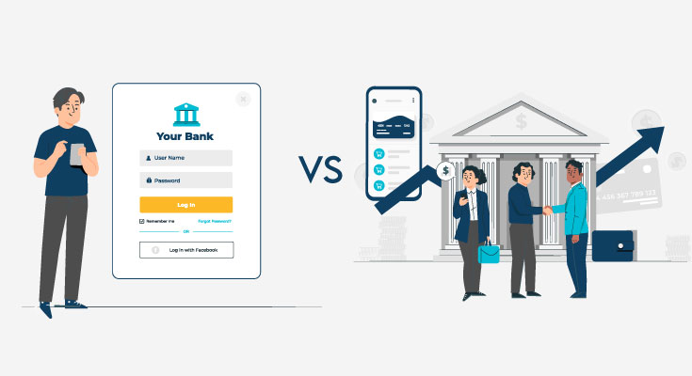
Generalist: Digital Banks vs Traditional Banks
Project Overview
Key Areas of Analysis
The emergence of neobanks has disrupted traditional banking by offering seamless digital experiences, lower fees, and innovative services.
Are their business models sustainable in the long-term?
The project explores whether neobanks can maintain profitability and growth, focusing on their financial performance, customer acquisition strategies, and business models, while comparing them with established traditional banks.
Examine revenue streams: subscription fees, transaction charges, and partnerships (neobanks) versus loan interest and wealth management (traditional banks).
Identify the types of customers attracted by neobanks and traditional banks, focusing on demographics, average deposits, and retention rates.
Methodologies:
Analysis of financial statements, sector reports, and case studies
Use of tools like Excel, Python or R for interactive and visually compelling analysis.
Team members
3 - 4 students
Individuals who have skills in financial analysis and software like Excel and Python/R.
November 20, 2024

Slide 20
Generalist: AI In Investment Decisions: Pros and Cons
Success Maximization and Loss of Humanity
Project Overview
Technological Analysis
Study the different types of AI technologies that are used to maximize success rates in investment decisions, compare outcomes with human investments.
Analyze the benefits of eradicating sources of bias in investments.
AI is transforming investment decision making.
Venture capital and investment firms are increasingly relying on AI to analyze multiple sources of data, predict trends, and make decisions with greater efficiency.
Can AI fully replace the human judgment aspect in investment decisions, and what concerns or benefits does this bring?
Traditional VC
VC decisions rely on trust and interactions with founders.
Explore different types of bias in these personal interactions such as confirmation bias, gender bias, similarity bias and how specific AI technology would eradicate these sources of bias.
Limitations
AI technology may fully dissolve human interactions which has risks :
Startups with impressive leadership but limited data may struggle to secure funding.
Explore the necessity of human relationships in investments.
Team Members
3- 5 students
Individuals with knowledge in machine learning
Individuals who enjoy researching and analyzing data to produce reports .
November 20, 2024

Slide 21
C
Data Analysis Division

Slide 22
Data Analysis : Machine learning for credit card fraud detection
Project Overview
Deliverables
Machine learning algorithms are widely used to detect fraudulent transactions.
We will discuss main algorithms used for fraud detection, how the work and what parameters they use to find fraudulent transactions.
We will implement the discussed models and test them on data from Kaggle and recent data from the ECB Data Portal.
A report discussing main machine learning models used for fraud detection and our empirical findings on how good they are to find fraud in our data
A Python notebook implementing the discussed models
Team members
3 - 5 students
Individuals who are interested in machine learning and its practical application to topics in banking
Previous knowledge of machine learning algorithms is not necessary. We will learn everything during the project
November 20, 2024

Slide 23
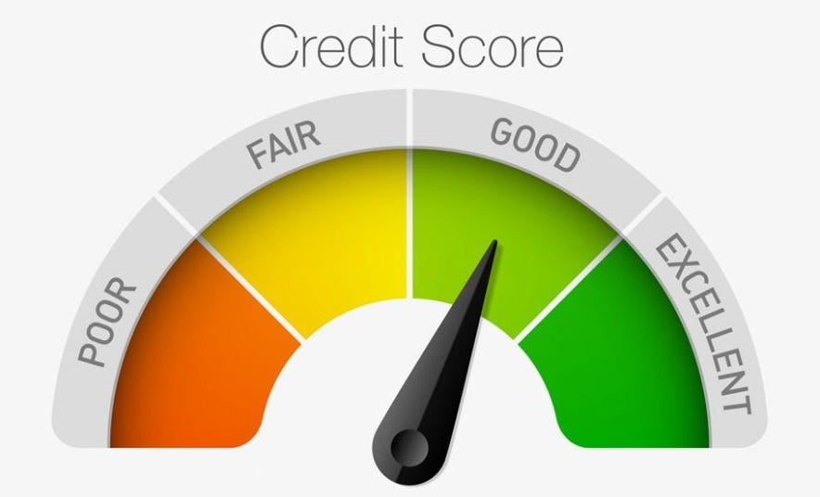
Data Analysis : Machine learning for credit scoring
Project Overview
Deliverables
We will discuss main machine learning algorithms used for credit scoring, how the work and what parameters they use.
We will also research what legal and ethical limitations have to be taken into account when creating credit scoring algorithms
We will implement the discussed models and test them on datasets from German and Australian banks that include information on loan granting and repayment.
A report discussing main machine learning models, legal and ethical constraints as well as our empirical findings on how good the models predict loan repayment for our data
A Python notebook implementing the discussed models
Team members
3 - 5 students
Individuals who are interested in machine learning and its practical application to topics in banking
Previous knowledge of machine learning algorithms is not necessary. We will learn everything during the project
November 20, 2024

